Slide 1
Basic microbiology
Part 3

Slide 2
BIOCHEMICAL CHARACTERISTICS
Fermentation test
Fermentation is a metabolic process that converts sugar to acids, gases, or alcohol. It occurs in yeast and bacteria, and also in oxygen-starved muscle cells, as in the case of lactic acid fermentation
an anaerobic enzyme decomposition of organic compounds usually carbohydrates in which part of the substrate is oxidized and part reduced to produce carbon dioxide, acids and alcohol as by-products.

Slide 3
Must contain a vial (Durham tube to collect the gas
Must contain an indicator to detect any acid formation. Indicators include
Bromocresol purple changes from purple to yellow
Methyl red changes from red to yellow
Methyl orange changes from red to yellow

Slide 4
Phenol red from yellow to red.
Phenolphthalein from colourless to pink
Bromothymol Blue from green grass to yellow
https://www.micro.iastate.edu/video/microbiology-007-carbohydrate-fermentation-test

Slide 5
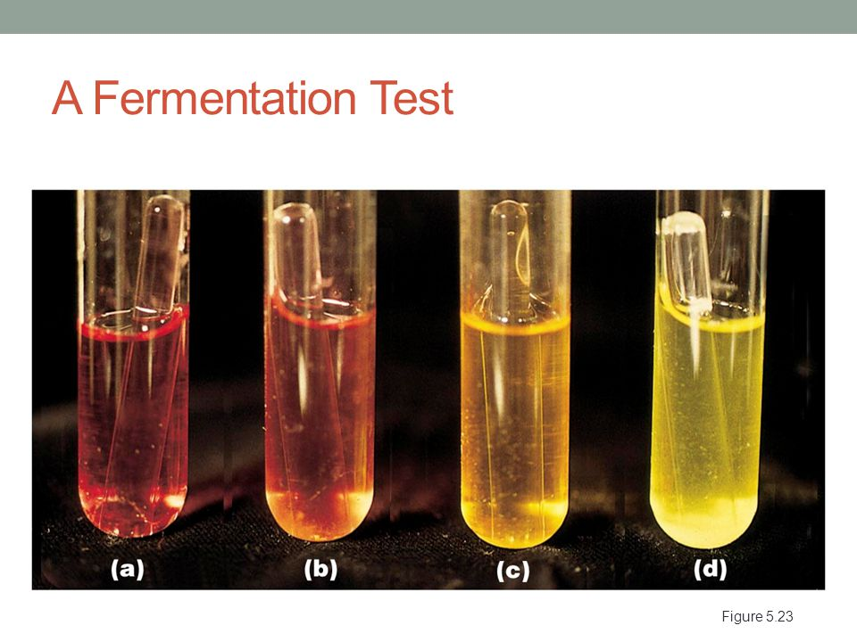
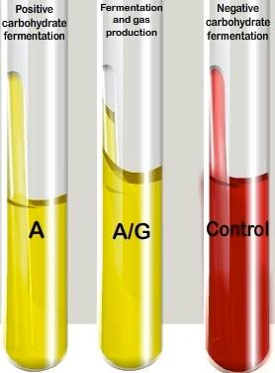

Slide 6
Hydrogen Sulphide
This test determines whether the microbe reduces sulfur-containing compounds to sulfides during the process of metabolism
If sulfide is produced, it combines with iron compounds to produce FeS, a black precipitate.
E.g. Salmonella paratyphi B causes gastroenteritis but the S. paratyphi A doesn’t
The two can be differentiated by using the hydrogen sulphide test: S. paratyphi B produces H2S but the paratyphi A doesn’t.

Slide 7
Hydrogen Sulphide
Two methods can be used
Moist lead acetate paper turns black in the presence of H₂S gas
or
the lead acetate can be incorporated into the medium and stab the organisms into the medium.

Slide 8
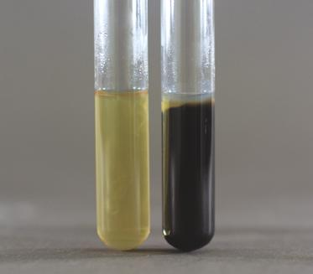
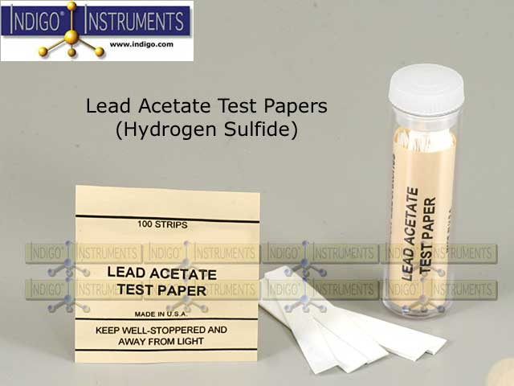
Hydrogen Sulphide

Slide 9
Catalase Test
Catalase is an enzyme which catalysis the breakdown of hydrogen peroxide to water and free oxygen.
Catalase is produced by many bacteria species
Micrococcus, Bacillus and Staphylococcus but not for e.g. in Lactobacillus
Use 3% hydrogen peroxide and the rapid elaboration of oxygen bubbles occurring indicates a positive test .

Slide 10
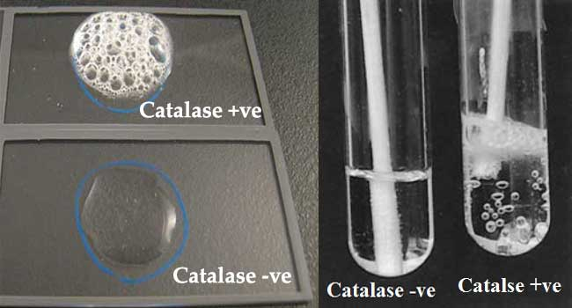
Catalase Test

Slide 11
Catalase Test
Catalase-positive bacteria include strict aerobes as well as facultative anaerobes. They all have the ability to respire using oxygen as a terminal electron acceptor.
Catalase-negative bacteria may be anaerobes, or they may be facultative anaerobes that only ferment and do not respire using oxygen as a terminal electron acceptor (ie. Streptococci)

Slide 12
Coagulase test
Coagulase test is used to differentiate Staphylococcus aureus (positive) from Coagulase Negative Staphylococcus (CONS).
Coagulase is an enzyme produced by S. aureus that converts (soluble) fibrinogen in plasma to (insoluble) fibrin.
Staphylococcus aureus produces two forms of coagulase, bound and free

Slide 13
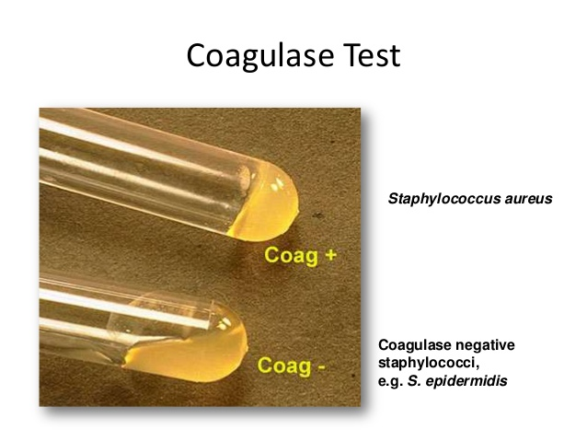
Coagulase test

Slide 14
Oxidase Test
A diagnostic test for the presence of cytochrome c using p-amino dimethyl aniline
Cytochromes are proteins that function as electron carriers in respiration and photosynthesis.
All bacteria that are oxidase positive are aerobic, and can use oxygen as a terminal electron acceptor in respiration
Use of oxidase strips………..

Slide 15
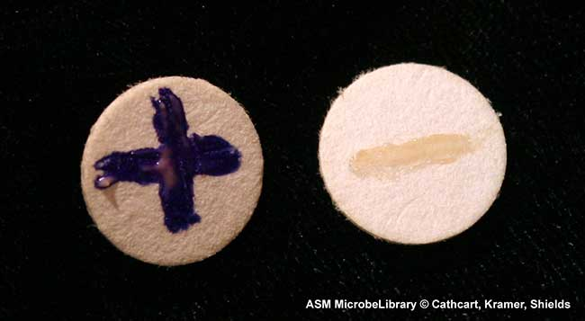
Oxidase Test

Slide 16
Proteolysis
Anything capable of hydrolyzing proteins
Can be demonstrated by the decomposition of gelatin
Test microbes are cultured on nutrient agar containing 1% gelatin
These are distributed into about 2 ml portions and stabbed with the test microbe
After incubation (5 hrs), several drops of acidified mercuric chloride is added
Hydrolysis is shown by a clear zone in the upper layer of the gelatin.

Slide 17
analytical profile index (API)
The AP system is a plastic strip of twenty microtubes (mini-test tubes) and cupules, partially filled with different dehydrated substrates
Bacterial suspension (in normal saline) of a pure culture is added to the microtubules, rehydrating the media and inoculating them at the same time
The strips are incubated (as directed by manufacturers) usually in a humidity chamber for 18-24 hours at 37°C
Colour changes take place in the tubes either during incubation or after addition of reagents.

Slide 18
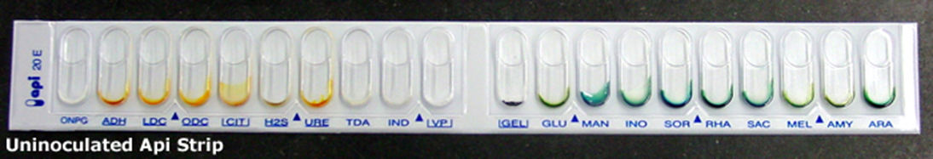
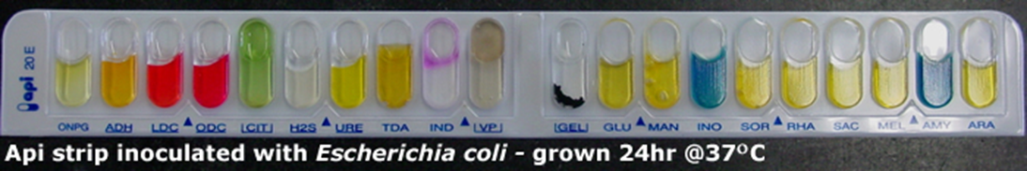
analytical profile index (API)

Slide 19
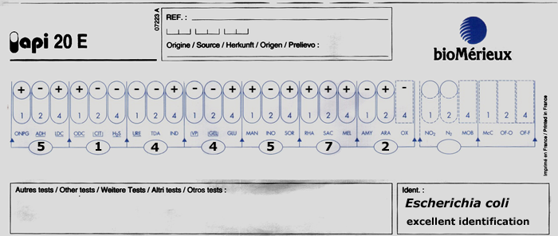
analytical profile index (API)

Slide 20
Few thoughts
One of the successes of modern medicine is the control of infectious diseases in the developed world
Typhoid, cholera, diphtheria are now rare and smallpox is eradicated globally
Reasons include
Improved sanitation
Improved nutrition
Good housing
Smaller families
Immunization
antibiotics

Slide 21
Pathogen non-pathogen
Staphylococcus aureus Staphylococcus albus
Boils, wound infections harmless, lives on skin Osteomyelitis, pneumonia
Corynebacterium diphtheria Corynebacterium xerosis
Diphtheria harmless, throat, skin
*Now there can be S. aureus without illness and S. albus damaging heart valves and prosthetic joints

Slide 22
Infection sustained uncontrolled growth of microbes, doing the patient some harm
Colonisation: presence of microbes which is well controlled and only has the potential for harm
Colonising microbes can go on to cause infections when our defences are impaired
Defences?????

Slide 23
General Health: Measles in healthy and malnourished child
Mechanical: intact skin, flushing urine, coughing up phlegm, prevent microbes gaining access
Immunity: protects us against diseases but also make transplant difficult.
Ability of an individual to resist infection
Lowered resistance: Poor nutrition, ill health
Invasion: surgery, catheters, cannulas, intubation, prostheses
Immunosuppression: malignancy, drugs, illness, AIDS

Slide 24
Opportunistic infection: where the occurrence or severity of an infection is determined by the condition of the patient rather than by the microbe. More virulent microbes are a lot worse and harmless microbes become serious
Nosocomial infection: infection occurring in hospital or hospital acquired infection
Infectivity: ease with which a microbe can spread or how easy it is to catch it

Slide 25
Serology
Microbes, should they enter a human system will stimulate it to produce antibodies.
An antigen is a molecule that stimulates an immune response or stimulates antibody generation.
Antigens are usually proteins or polysaccharides
This includes cell components such as coats, capsules, cell walls, flagella, fimbrae, and toxins of bacteria, viruses and other microbes
Non-microbial exogenous (non-self) antigens can include pollen, egg white, and proteins from transplanted tissues and organs or on the surface of transfused blood cells.

Slide 26

Antigens that enter the body from the environment; these would include
inhaled macromolecules (e.g., proteins on cat hairs that can trigger an attack of asthma in susceptible people)
ingested macromolecules (e.g., shellfish proteins that trigger an allergic response in susceptible people)
molecules that are introduced beneath the skin (e.g., on a splinter or in an injected vaccine)

Slide 27
`
Serology
Antibodies are proteins that circulate freely in the blood or other body fluids and often combine in a highly specific way with the microbes that caused their production
and are used by the immune system to identify and neutralize foreign objects, such as bacteria and viruses.
E.g. the immune system of an animal injected with killed cholera bacteria (antigen) responds by producing antibodies against the cholera bacteria

Slide 28
Serology
Antisera (antiserum) are commercially available solutions of such antibodies used in the identification of many medically important microbes
If an unknown microbe is isolated from a patient, it can be tested against known antisera and often identified quickly.

Slide 29
Slide agglutination test
Slide Agglutination tests are used to test an unknown organism against known antisera.
Used in the serotyping of Salmonella species.
Bacteria, provided they form stable suspensions in saline, can be agglutinated directly by antibody.

Slide 30
Bacterial agglutination tests may be performed on a slide, in microtitre tray wells or in tubes.
Tube agglutination tests are usually more sensitive than slide tests as they require a longer incubation period which allows more antigen and antibody to interact
Here samples of an unknown microbe are placed in a drop of 0.85% saline on each of several slides.

Slide 31
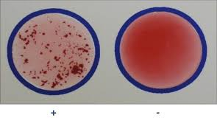
Then a different known antiserum is added to each sample.
The microbe agglutinate (clump) when mixed with antibodies that were produced in response to that species or strain of microbe, a +ve test is indicated by the presence of agglutination.

Slide 32
ELISA (Enzyme-linked immunosorbent assays)
ELISA is a fundamental tool of clinical immunology used as an initial screen for HIV detection
Based on the principle of antibody-antibody interaction
Test allows for easy visualization of results

Slide 33
ELISA (Enzyme-linked immunosorbent assays)
They are now widely used because they are fast and can be read by a computer scanner
ELISA, known antibodies are placed in the wells of a microplate
and an unknown type of bacteria is added to each well
A reaction between the known antibodies and the microbe provides identification of the microbe ELISA is used in AIDS testing worldwide.

Slide 34
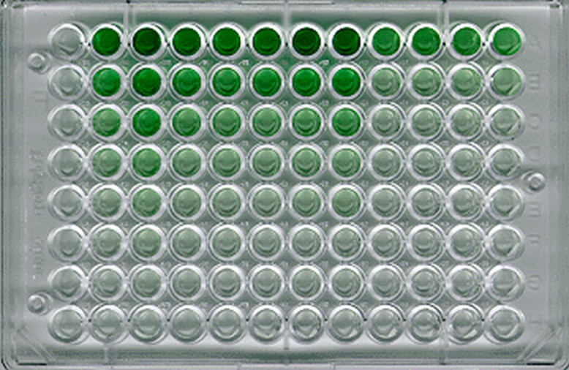
ELISA is the first and most basic test to determine if an individual is positive for a selected pathogen, such as HIV.
The test is performed in a 8 cm x 12 cm plastic plate which contains an 8 x 12 matrix of 96 wells, each of which are about 1 cm high and 0.7 cm in diameter.

Slide 35
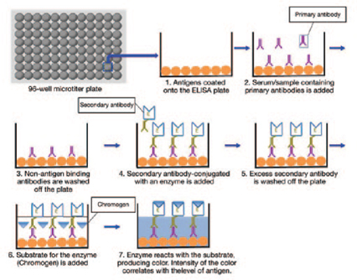

Slide 36




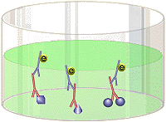
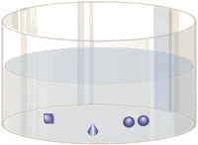
The Elisa Method
Partially purified, inactivated HIV antigens pre-coated onto an ELISA plate
Patient serum which contains antibodies. If the patient is HIV+, then this serum will contain antibodies to HIV, and those antibodies will bind to the HIV antigens on the plate
Anti-human immunoglobulin coupled to an enzyme. This is the second antibody, and it binds to human antibodies.
Chromogen or substrate which changes color when cleaved by the enzyme attached to the second antibody

Slide 37
False positives
It is entirely possible that an individual not infected with HIV has antibodies which may give a positive result in the HIV ELISA
This is called a false positive.
One reason for this is that people (especially women who have had multiple pregnancies) may possess antibodies directed against human leukocyte antigens (HLA) which are present on the host cells used to propagate HIV.

Slide 38
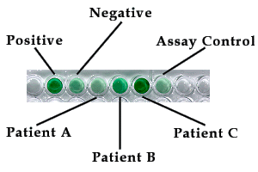
As HIV buds from the surface of the host cell, it incorporates some of the host cell HLA into its envelope. False negatives can occur during the window between infection and an antibody response to the virus (seroconversion)

Slide 39
Positive Control | Negative Control | Patient A | Patient B | Patient C | Assay Control
1.685 | 0.153 | 0.055 | 0.412 | 1.999 | 0.123

Slide 40
Above is ELISA data from three patients. Numbers are expressed as optical density at 450 nm. The cutoff value indicating a positive result is 0.500
Optical densities of 0.300 to 0.499 are indeterminate and need to be retested
Values below 0.300 are considered to be negative
In most cases, a patient will be retested if the serum gives a positive result.
If the ELISA retests are positive, the patient will then be retested by western blotting analysis.

Slide 41
Western Blot
Western blot is a method used in detecting a specific protein in a given sample of tissue homogenate or extract
It uses gel electrophoresis to separate native or denatured proteins by the length of the polypeptide (denaturing conditions) or by the 3-D structure of the protein (native/ non-denaturing conditions)
Gel electrophoresis is a technique used for the separation of DNA, RNA, or protein molecules using an electric current applied to a gel matrix.

Slide 42
The proteins are then transferred to a membrane (typically nitrocellulose)
where they are probed (detected) using antibodies specific to the target protein
Now many companies specialize in providing antibodies (both monoclonal and polyclonal antibodies) against many thousands of different proteins.

Slide 43
Previously large animals (e.g. sheep, goat - lots of serum) had to be immunised with the target protein twice (secondary immune response generates high affinity antibodies)
Then either serum could be purified and used (polyclonal antibodies)

Slide 44
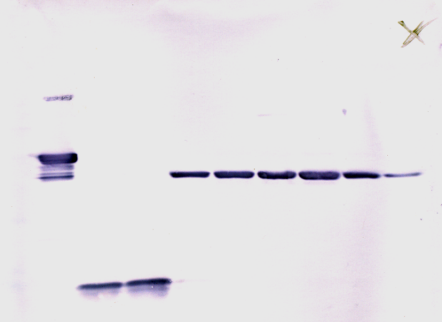
Bacterial proteins in the patients serum are separated by a process called electrophoresis
Proteins are then transferred to a filter by blotting.
Antibodies tagged with a dye are washed over the filter
If the specific antigen (in this case the microbe proteins) is present in the serum, the antibodies will combine with it and will be visible as a coloured band on the filter

Slide 45
The method originated from the laboratory of George Stark at Stanford.
The name western blot was given to the technique by W. Neal Burnette and is a play on the name
Southern blot, a technique for DNA detection developed earlier by Edwin Southern.
Detection of RNA is termed northern blotting

Slide 46
Phage typing
Bacteriophages are bacterial viruses that usually cause the breakdown or lysis of bacteria cells they infect.
They are used in looking for similarities amongst organisms and is therefore useful in tracing disease outbreak sources.
Phage typing is highly specialized as they usually infect only members of a particular species, or even particular strains within a species.
Flood a agar plate with the bacterial culture or suspension.

Slide 47
Drops of each different phage type to be used in the test is then placed on the bacteria.
Whenever the phage are able to infect and lyse the bacteria cells, clearings in the bacteria growth called plagues appear.
Such a test might show that the bacteria isolated from a surgical wound have the same pattern of phage sensitivity as those isolated from the operating surgeon or surgical nurses. This establishes that the surgeon or nurse might be the source of infection

Slide 48
BACTERIA CLASSIFICATION
Systematic arrangement of organisms into some system of reference
i.e. groups or categories - taxa based on their distinguishing characteristics or features or based on their similarities
There are several difficulties with the classification of bacteria for example because

Slide 49
There are no natural species boundaries because multiplication is asexual
We can only depend on theory to learn about evolutionary and phylogenetic history of a species.
Bacteria left no fossil evidence and therefore their evolution is a mere speculation
many characteristics of microbes are subject to change

Slide 50
This explains why many bacterial classification systems have depended on descriptive keys for identification of an organism.
When new organisms are encountered references are made to sample cultures kept at collection centres
e.g. American Type Culture Collection (ATCC),
International Collection of Phyto-pathogenic bacteria
Again some microbes may have the distinctive features of others

Slide 51
Research ‘s manipulation of genetic constitution of bacteria for research activities and other commercial ventures

Slide 52
What is the way out?
To rely on qualitative characteristics which has produced a more stable classification systems
e.g. form, motility, oxygen requirement
These are less subject to change unlike the quantitative characteristics like size, rate of growth, pigment intensity etc.

Slide 53
Microbiologists have cooperated in the use of standardized procedures, knowledge of characteristics that are variable, knowledge and appreciation of the general principles and problems of taxonomy.
Nomenclature is the application of names both to the microbes themselves and also to the groups in which they are placed.
The name should be descriptive and binomial.

Slide 54
The first name refers to the genus starting with an uppercase letter and the second name is the epithet of the first name
It may refer to the colour, origin or the disease. A name is either descriptive, Geographical or commemorative.
Identification is the recognition of microbes and involves marching microbes with those already known.

Slide 55
DIFFERENT CLASSIFICATION SCHEMES
A species is a group of cells that show a high degree of overall phenotypic similarity and that differ from related cell groups.
The species concept in microbiology is often doubtful in bacteria.
Theoretically it is a kind of bacteria with identical or near so individual cells. In reality however, mutant forms always exist in a given population even though they may sometimes be temporary.

Slide 56
NATURE OF VIRUSES
Viruses are very small microorganisms that can only be seen with the electron microscope.
They are acellular.
Contain only a single type of nucleic acid, either DNA or RNA
Normal living cells all have DNA and RNA and therefore viruses can only reproduce by using the cellular material of other organisms
contain a protein coat (sometimes itself enclosed by an envelope of lipids, proteins and carbohydrates) that surrounds the nucleic acid
This protein coat structure is called CAPSID and often has antigenic specificity

Slide 57
Capsid is made up of many structural units called CAPSOMERESS
The composition and numbers and forms of which vary with different kinds of viruses.
capsid is physiologically inert.
Multiply inside living cells by using the synthesizing machinery of the cell
They have a few or no enzymes for their own metabolism
For example they lack the enzymes for protein synthesis and ATP generation.

Slide 58
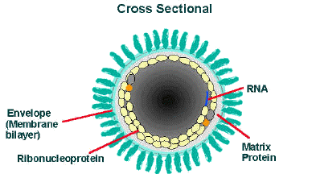
Rabies virus

Slide 59
Viruses are most difficult to handle in medical science, WHY?
because most drugs that would interfere with viral multiplication would also interfere with the functioning of the host cell and hence are too toxic for clinical use
However, the presence of lipids in the coverings of some viruses makes these viruses sensitive to disinfection (outside the host cell)
For example, a 1:10 dilution of household chlorine bleach can inactivate HIV (the AIDS virus, which is in the genus Lentivirus) outside the body.

Slide 60
Viruses are about 20 – 14000 nm in length.
Animal viruses are enveloped
Plant and Bacteria viruses are non-enveloped
The viral particle exhibit a great variety of shapes and sizes
Some appear as rids which on careful examination prove to be helical e.g. influenza virus
Spherical forms characteristic of polyhedral herpes virus

Slide 61
A combination of helical and spherical forms i.e. a polyhedral head attached to a spherical tail, is common among phages
but is never found in animal or plant viruses. Usually all the nucleic acid material is in the head and the tail is only an organ of attachment.

Slide 62
Viruses can infect a host of microorganism including inverts, verts, plants, protists, fungi and bacteria
Viruses that infect bacteria are called Bacteriophages or phages
Viruses are all parasites.
Many diseases of humans are known to be caused by viruses and are responsible for thousands of deaths
Viruses were previously endemic (low levels of infection in localised areas but have now crossed the species barrier
Polio was endemic but now a Pandemic (high levels of infection worldwide)

Slide 63
Polio spread has been due to urban populations that have developed as a result of the industrial revolution providing an ideal environment.
Polio vaccine in 1950 has halted the spread but still pockets of infection. WHO said it will eradicate it by 2006

Slide 64
Measles population and travel
Reservoir (healthy individuals harbouring an infectious agent that is available to infect another host)
Vector (carriers) for a virus
Yellow fever – carried by Aedes aegypti but now also by Haemagogus
Stayed amongst monkeys until people involved in timber cut the trees to enable the mosquito come to the forest floor and infect humans

Slide 65
Many virologist believe that similar events have occurred in the case of the Human immunodeficiency virus (HIV)
Retrovirus which are similar to HIV exist in domesticated cats called the FIV
Feline Immunodeficiency virus in 1987
Simian AIDS, immune deficiency disease in green monkeys reported in 1986
It is possible that a mutated form of SIV crossed over to humans from contact with an infected monkey
Antibodies to SIV have been found in humans

Slide 66
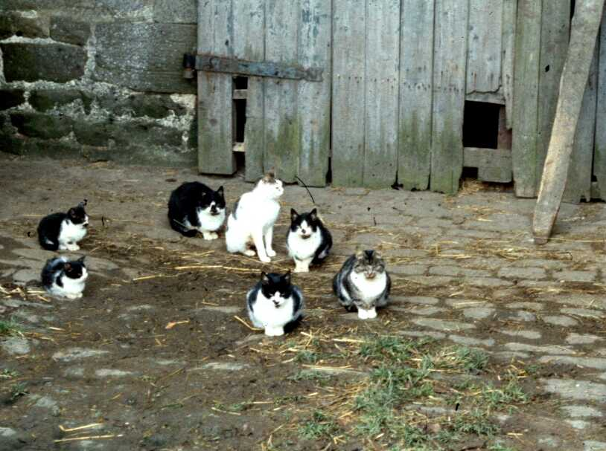
CATS AND DISEASE

Slide 67
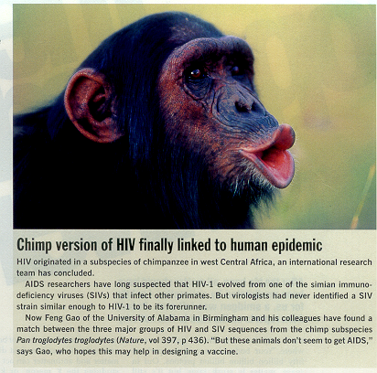
In spite of the many theories, e.g., polio vaccine or life-style it seems that the original theory that human mmuno-
deficiency virus
evolved from simian
viruses (SIVs)
is correct

Slide 68
In USA is an emerging virus called Hantavirus
It is transmitted by Rodents faeces and urine to humans
It causes Hantavirus Pulmonary Syndrome
Also causes haemorrhagic fever
It is an acute often fatal respiratory disease
Bats - Nipah virus
birds - West Nile virus
Dengue fever
Influenza virus

Slide 69
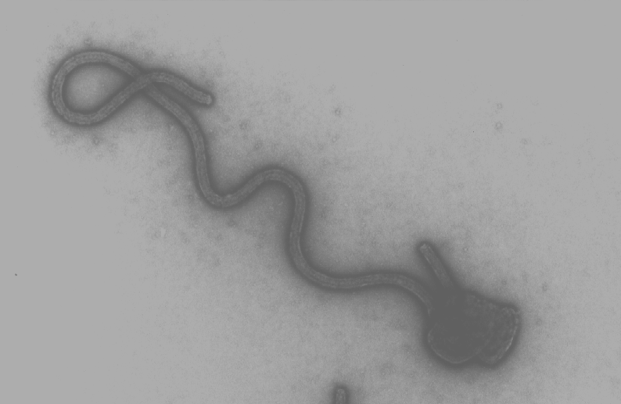
Ebola virus Unknown route of transmission (highly infectious through contact with body fluids); Zoonotic virus

Slide 70
Why they are appearing now
Travel to increasingly exotic locations (esp. last minute with no time for vaccinations)
Pilgrimages (Hajj in 2000 - meningitis)
Cruise ships – winter vomiting disease
Travel getting closer to nature
Forest clearance and eating (and/or importation) of bush meat:
This leads to increased contact with animals, their bodily excretions and their faeces, frequently in an aerosolised dust

Slide 71
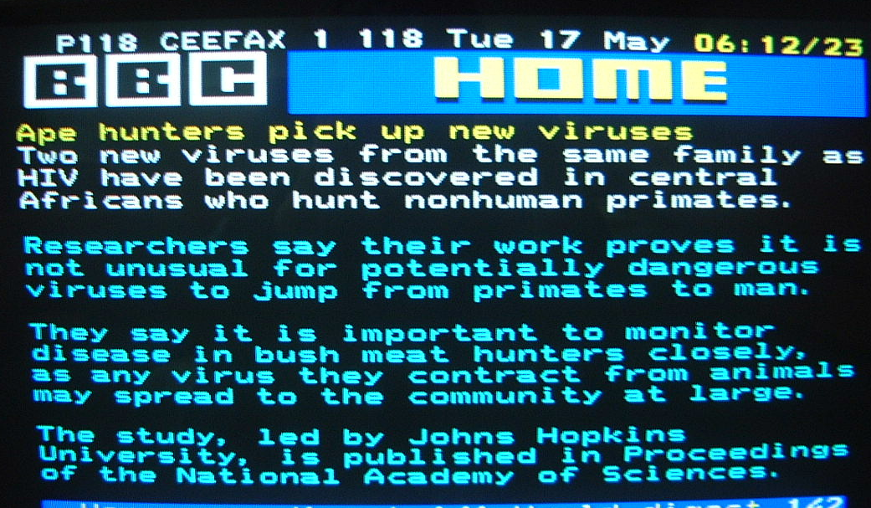

Slide 72
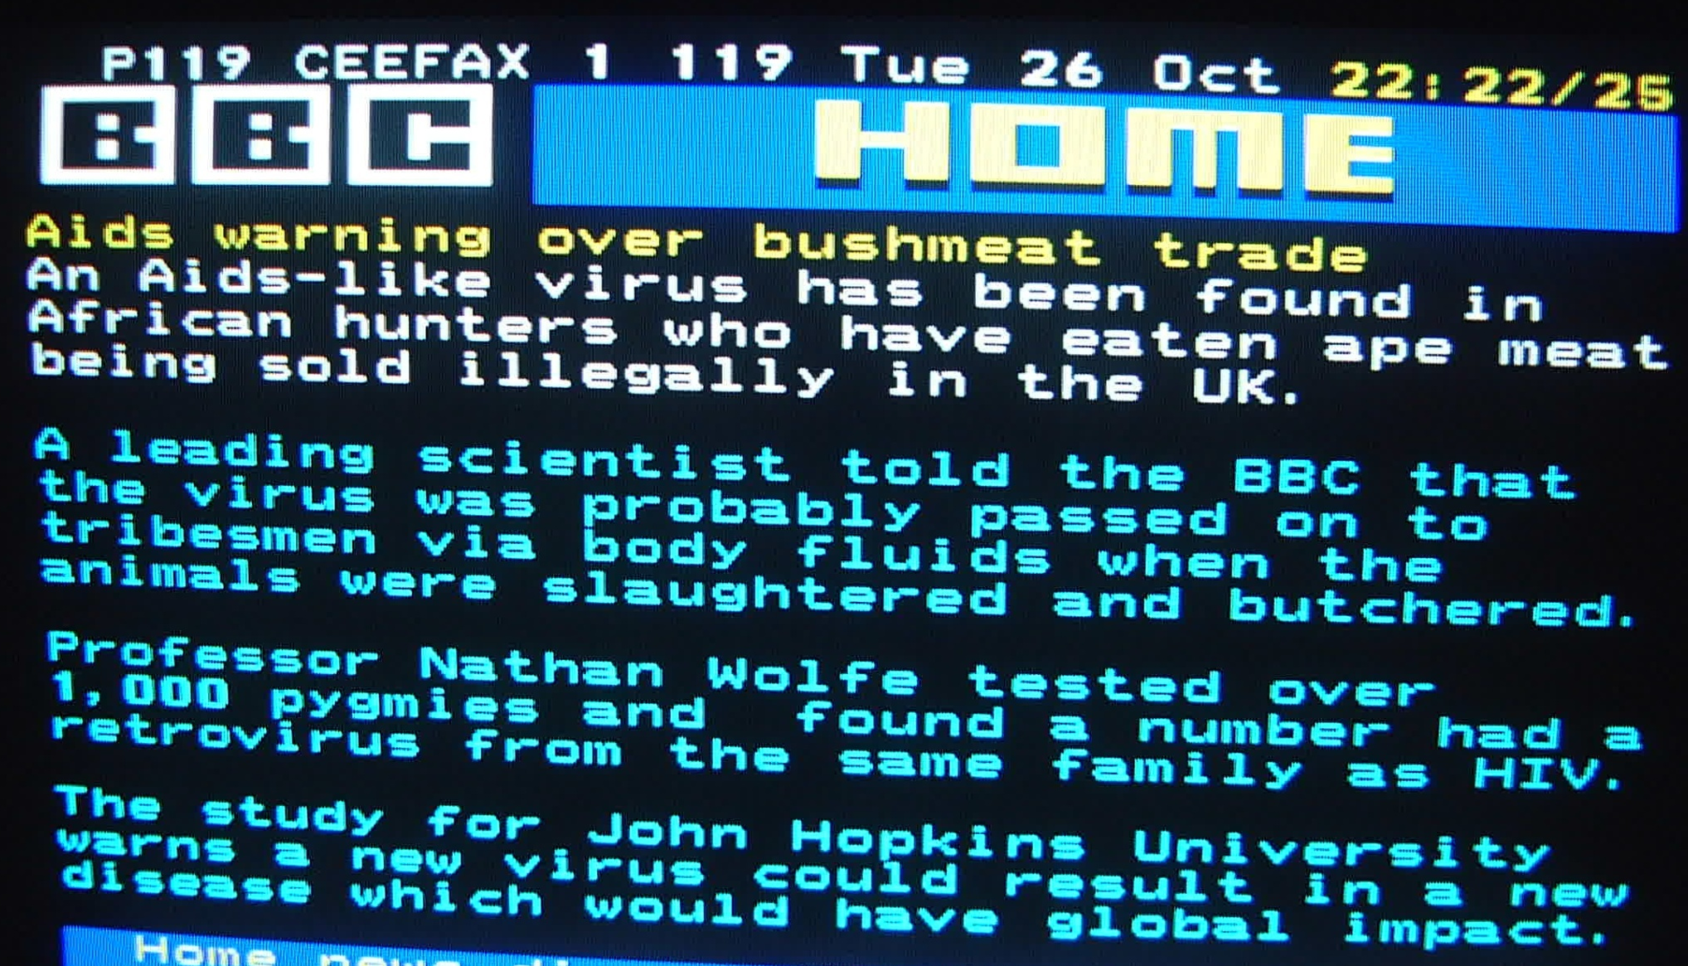

Slide 73
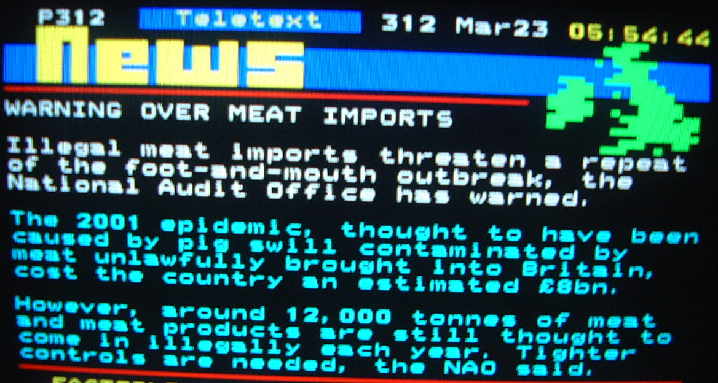

Slide 74

World wide travel

Slide 75
Emerging and re-emerging viral diseases
Most emerging diseases are zoonosis and viruses:
DISEASE ANIMAL RESERVOIR
Hanta, lassa fevers rodents
Rift valley virus cattle and sheep
HIV monkeys
Nipah virus bats
West Nile virus birds
Avian flu birds
Ebola /Marburg ?
SARS* Horse shoe bats, civet cats *severe acute respiratory syndrome

Slide 76
DETECTION AND ENUMERATION OF VIRUSES
Plague method where bacteriophage is used
Growth of animal viruses in the laboratory. Involves using living animals like mice rabbits and guinea pigs. Following Koch’s postulate.
However, some human viruses cannot be grown in animals or can be grown but do not cause disease
This has been the problem with the slow progress made in HIV research because there are no animal models for the disease, HIV virus

Slide 77
For example Chimpanzees can be infected with the HIV 1 virus i.e. Lentivirus but because they do not show symptoms of the disease, they cannot be used to study effects of viral growth and disease treatment
This explains why AIDS vaccines or drugs are presently being tested in humans in Kenya and South Africa, but the disease progresses so slowly in humans that it can take years to determine the effectiveness of these vaccines

Slide 78
A breakthrough in this area of worry has been resolved. Presently, genetically engineered human T cells and human gamma globulin is being produced by mice and therefore it is now possible to infect them with human AIDS.

